Slide 1



















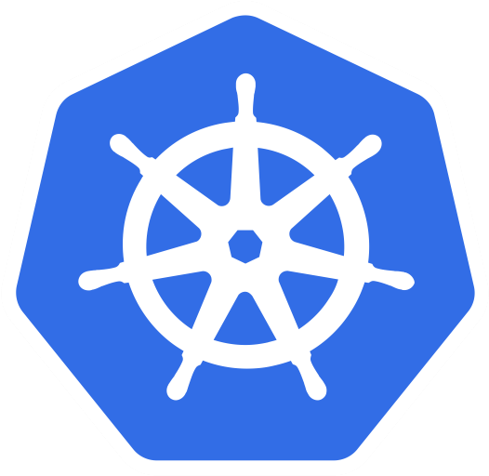
1. Why Kubernetes?
As-Is
To-Be
A
B
C
A
B
C
A
B
C
A
B
C
A
B
C
A
B
C
Auto Scaling
Blue Green
Canary
Deployment
Auto Healing
- Blue Green
v1
v1
v1
v2
v2
v2
v1
v1
v1
v1
v1
v2
- Canary
- RollingUpdate

Slide 2






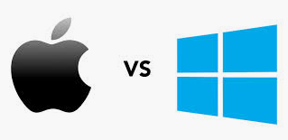
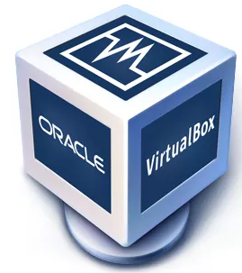


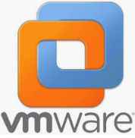


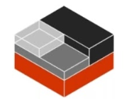

2. VM vs Container
Virtual Machine
Container
A Service
B Service
Container
Guest OS
Guest OS
Hypervisor
docker
rkt
LXC
Host OS
Host Server

Slide 3
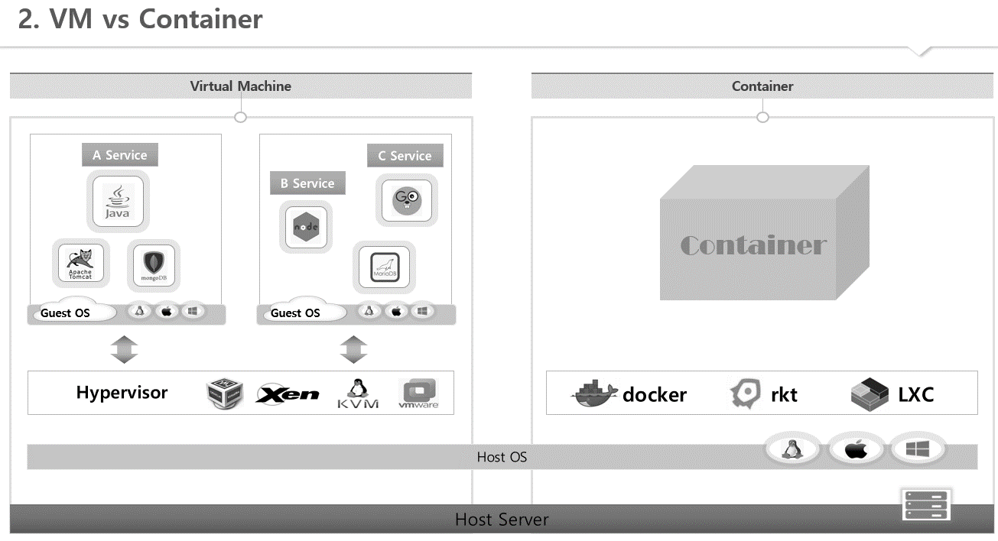





Container
A Service
Version 1.6
A Service
B Service
Container
Version 1.6
Version 3.6
Container
Container
A Service
namespace
mnt, pid, net, ipc, uts, user
C Service
Version 1.6
Version 1.8
memory, CPU, I/O, network
cgroups
Version 1.8
Version 10
Container
Linux 6
Linux 7
Linux 7

Slide 4

2. VM vs Container
Virtual Machine
Container
A Service
C Service
A Service
B Service
B Service
Version 1.6
Version 3.6
Container
Container
C Service
namespace
Guest OS
Guest OS
cgroups
Version 10
Container
Hypervisor
docker
rkt
LXC
Host OS
Host Server

Slide 5

2. VM vs Container
Virtual Machine
Container
Service
Pod
Pod
Service
Service
Module A
Module C
Pod
Module A
Module A
Module B
Module B
Module C
Container
Container
Pod
Module C
Module C
Module B
Module C
Container
Guest OS
Guest OS
Container
Container
Hypervisor
Kubernetes
Host OS
Host Server

Slide 6





3. Getting started - Kubernetes
Docker Hub
Docker Hub
Hello
World
8000
8100
8200
Service
Hello
World
8000
8000
Hello
World
Hello
World
Container
Container
Pod
Linux
Docker
Kubernetes
Dockerfile
Pod
Service
FROM node:slim
EXPOSE 8000
COPY hello.js .
CMD node hello.js
apiVersion: v1
kind: Pod
metadata:
name: hello-pod
labels:
app: hello
spec:
containers:
- name: hello-container
image: tmkube/hello
ports:
- containerPort: 8000
apiVersion: v1
kind: Service
metadata:
name: hello-svc
spec:
selector:
app: hello
ports:
- port: 8200
targetPort: 8000
externalIPs:
- 192.168.0.30

Slide 7
4. Kubernetes Overview
Object
Controller
Kubernetes Cluster
Replication Controller, ReplicaSet
Namespace
Service
External
Pod
Pod
Pod
Pod
Pod
Pod
Pod
Container
Container
Volume
Deployment
Namespace
ResourceQuota
/ LimitRange
ConfigMap
/ Secret
ReplicaSet v1
ReplicaSet v2
Pod v1
Pod v2
Pod v1
Pod v2
Controller
Pod v1
Pod v2
Pod
Pod
Pod
DaemonSet
CronJob
Node
Node
Job
Job
Master
Node1
Node2
Node3
Pod
Pod
Physical Machine
Pod
Pod

